Slide 1

Social Media Addiction, Fear Of Missing Out and Self Esteem
By
Aryamon Hooda – 21UCC025
Adi Mathur – 21ucc007

Slide 2
What is an Addiction?
A state of being physically and mentally dependent on a particular substance heavily.
Mark Griffiths (1996) : addiction involves a pattern of behavior that leads to negative consequences, loss of control, and a strong compulsion to engage in the behavior despite these consequences.

Slide 3
Substance and Behavioral Addiction
Substance addiction is a fatal brain disease that is characterized by loss of control, denial and relapse. It is also marked by continued use of substances despite harmful consequences.
Behavioral addiction is similar to drug addiction except that in the former, the individual is not addicted to a substance but the behavior or the feeling brought about by the relevant action.

Slide 4
There are two sub-types of addiction – primary addictions and secondary addictions (Griffiths, 1995).
Primary addictions are those in which a person is addicted to the activity itself, and that individuals love engaging in the activity (Griffiths, 2005).
Secondary addictions as those in which the person engages in the behavior as a way of dealing with other underlying problems. Here the behavior is primarily engaged in to escape, to de-stress, or to relax.

Slide 5
Symptoms of Addiction
Salience – This occurs when the activity becomes the single most important activity in the person’s life and dominates their thinking, feelings, and behavior.
Mood modification – This refers to the subjective experiences that people report as a consequence of engaging in the activity and can be seen as a coping strategy.
Tolerance - This basically means that for someone engaged in the activity, they build up the amount of the time they spend engaging in the activity every day.
Withdrawal symptoms – These are the unpleasant feeling states and/or physical effects that occur when the person is unable to engage in the activity.
Conflict – This refers to the conflicts between the person and those around them and the conflicts with other activities.
Relapse – This is the tendency for repeated reversions to earlier patterns of excessive engagement in the activity to recur.
.

Slide 6
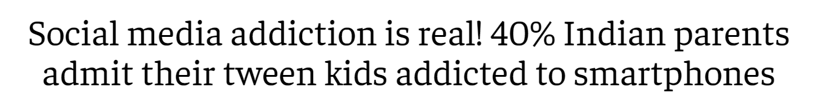
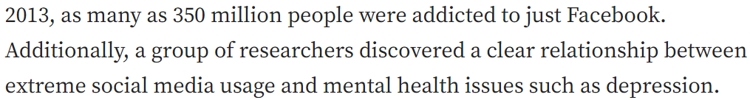
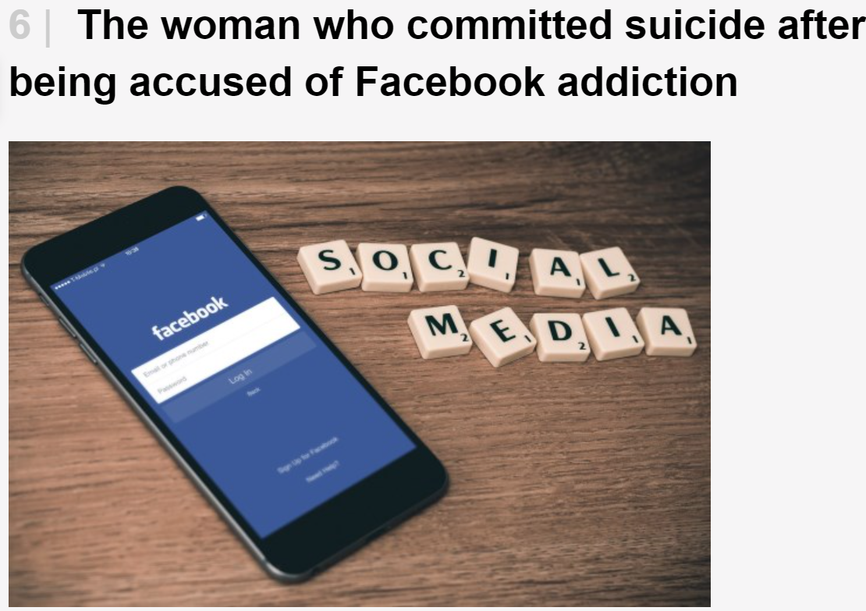
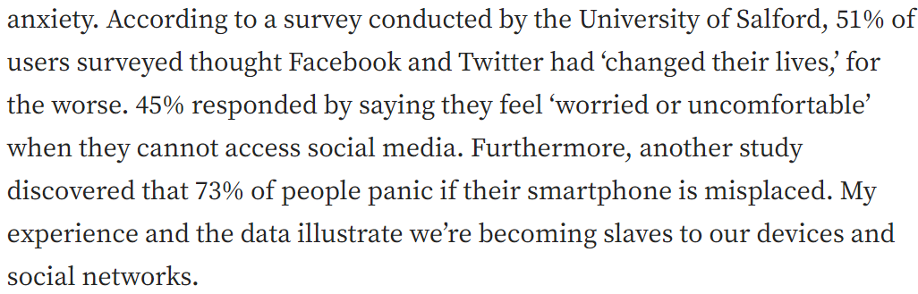

Slide 7
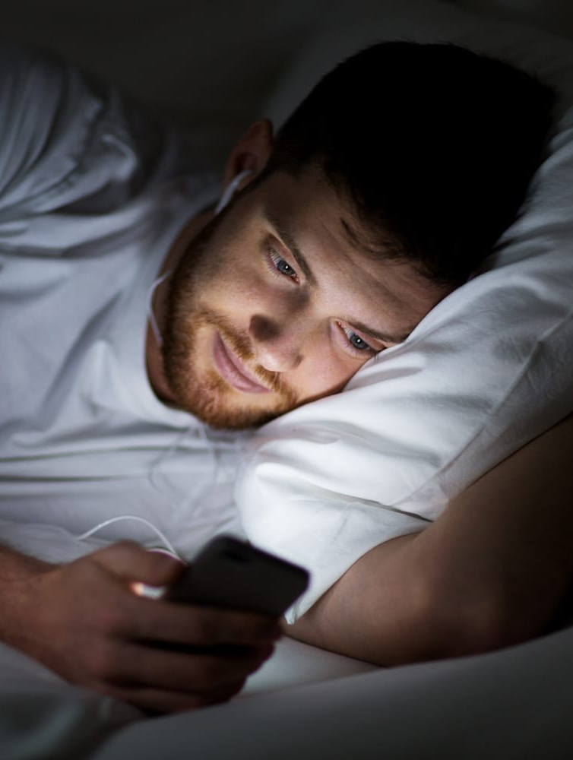
Introduction
Social Media has changed the way humans think , perceive and assess events around them.
The world has become more connected than ever, but it comes with its own hardships.

Slide 8

To stay connected or to stay relevant it is imperative that everyone is in social media in some way or another giving rise to addiction that impacts the mental well-being of those who are vulnerable.
Some of these problems we want to discuss are FOMO and Self-Esteem that is prevalent among the college students.

Slide 9
Objectives
To study impact of Social media addiction on FOMO.
To study the impact of FOMO on Self-Esteem.
To study the impact of Social Media Addiction on Self-Esteem.
To Study the impact of the mediating effect of FOMO on Social Media addiction and Self-Esteem.

Slide 10

Variables
This Study comprises of 3 variables:-
Social Media Addiction
Fear of Missing Out (FoMO)
Self-Esteem

Slide 11
Social Media
Social media are interactive technologies that facilitate the creation, sharing and aggregation of content, ideas, interests, and other forms of expression through virtual communities and networks.
From Facebook and Instagram to X platform (formerly Twitter) and YouTube, more than 4.9 billion people use social media, equal to roughly 62.3% of the world's population.

Slide 12
Social Media Addiction
Social media addiction ( Facebook addiction, SNSs addiction, and addictive SNSs use) is defined as a psychological dependency on Social Networks to the extent that behavioral addiction symptoms occur.
Addictive social media use is associated with negative consequences such as reduced productivity, unhealthy social relationships, and reduced life-satisfaction.

Slide 13
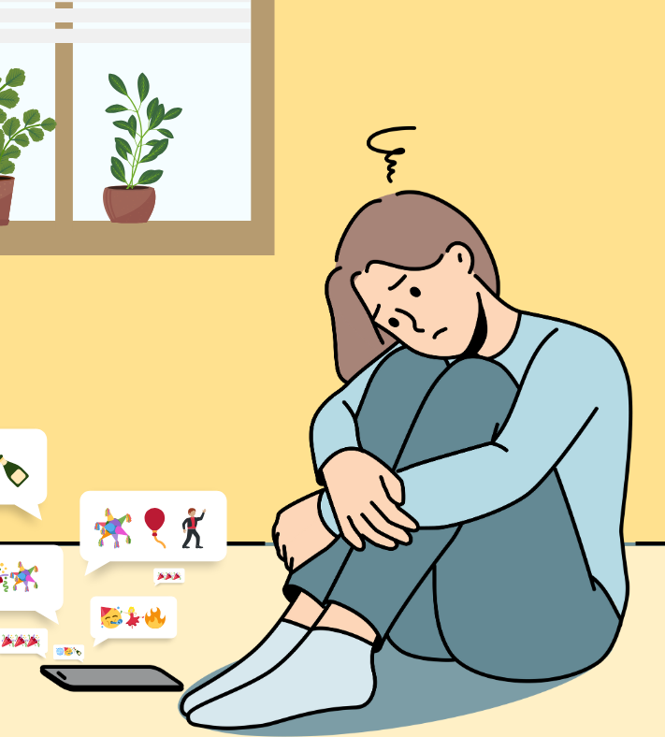
FOMO
The feeling of apprehension that one is either not knowing about or missing out on events and experiences that could make one's life better.
One of the symptoms of FoMO is the fear that other social media users have more rewarding life experiences. This leads to comparisons – “me” versus “others”.

Slide 14
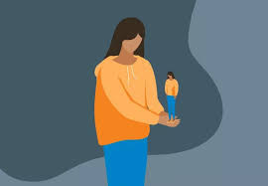
Self-Esteem
Self-esteem is the summation of beliefs regarding the individual’s self.
These beliefs are obtained through socialization, feedback, the looking-glass self, and self-perception (Taylor, Peplau, & Sears, 2007)

Slide 15
Social Media addiction and FOMO
Increased connectivity to SNS has been linked to a fear of missing out ,a state in which people become anxious that others within their social spheres are leading much more interesting lives (Przybylski, Murayama, DeHaan, & Gladwell, 2013).
Experiencing FOMO could undermine any psychological advantages gained from social networking sites.
Notes:
Doubt

Slide 16
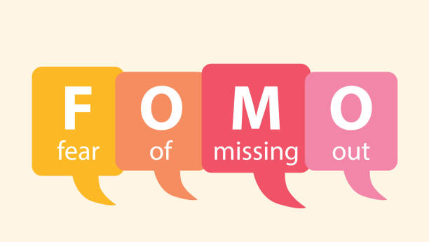
A recent survey showed that 80% of teenagers admit they use texting as the most common way to get in touch with their friends (van den Eijnden et al.,2010; Young, 1998) (Lenhart et al., 2015b) .
This emphasizes that social media use may increase the level of an individual's fear of missing out (Slater, 2007; Valkenburg et al., 2016).

Slide 17
FOMO and Self Esteem
SM researchers even suggest that self-esteem may be the basis of FoMO (Abel et al., 2016).
Fear of missing out is negatively correlated with self-esteem (Buglass et al., 2017).
(Ellison et al., 2007; Kapıkıran, 2013; Kong et al., 2013; Kong & You, 2013; Liu et al., 2013; Przybylski et al., 2013a; Wortham, 2011).People with lower self-esteem have increased FoMO that leads to stronger Social Media addiction.

Slide 18
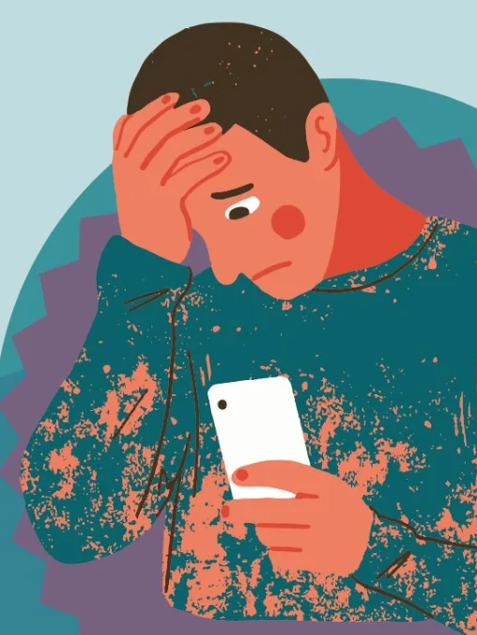
Social media users with high FoMO were characterized by lower levels of self-esteem compared to people with low FoMO. This observation correlates with the report by Giagkou et al. (2018).

Slide 19
Social Media Addiction and Self Esteem
Previous research has shown that lower self-esteem may be a risk factor for different forms of addiction (Gori et al., 2021a, Gori et al., 2021b)
Social media use may facilitate momentary increase in self-esteem. (Wilcox and Stephen (2013))
People with low self-esteem may use SNS to seek validation (Andreassen et al., 2017)
Notes:
Doubt – Can cut the last point.

Slide 20
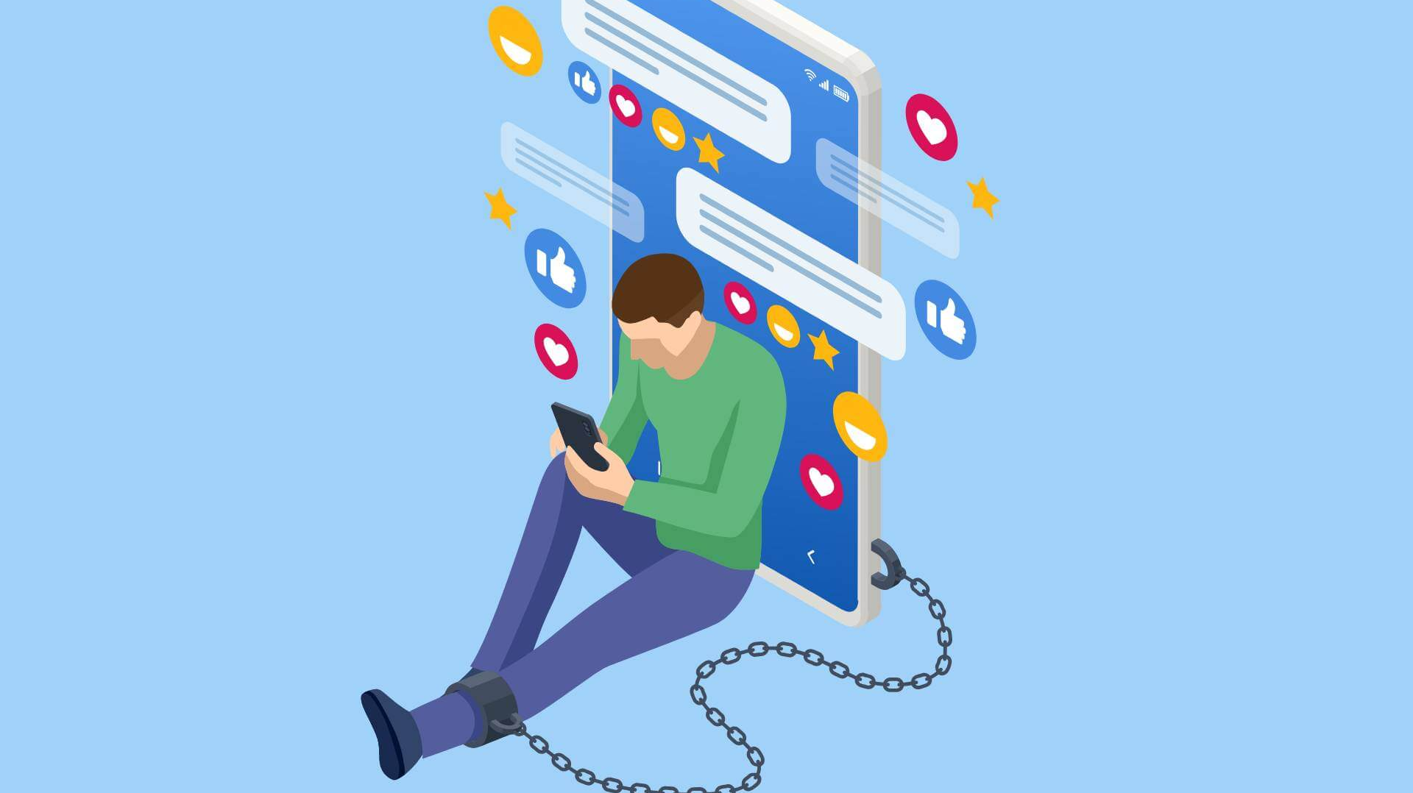
Mediating Variable FOMO
The present study argues that social networking addiction can perpetuate a state of ‘FOMO’, which can further lead to increase in usage of social media. Caught in this vicious cycle, one may experience low self -esteem.
FoMO is a mediator between self-esteem and Facebook addiction (Uram & Skalski, 2020).
Structural equation modelling (SEM) suggests that FOMO mediates the relationship between increased SNS use and decreased self-esteem.

Slide 21
Hypothesis
H1 : Social Media addiction will influence FOMO. H2 : Social Media addiction will influence Self-Esteem. H3 : FoMO will influence Self-Esteem. H4 : Social Media addiction will influence FOMO which in turn will affect Self-Esteem.

Slide 22
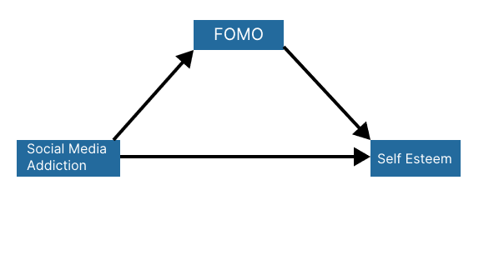
Conceptual Model
H1
H4
H3
H2

Slide 23
Method
Sample
Young adults are the focus of the study.
They have recently transitioned from a monitored environment at home to college.
Some struggle to adapt to college life and rely on social media for coping.

Slide 24
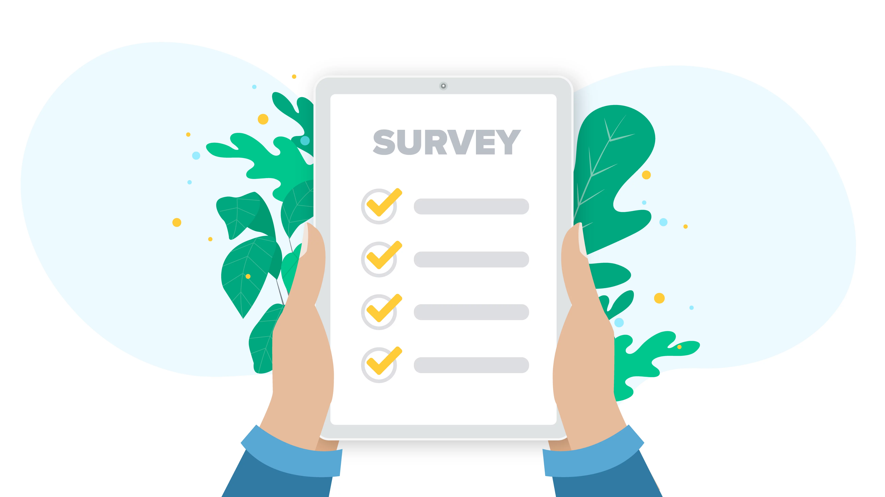
The research incorporates Snow-Ball Sampling.
Used when members of a population are difficult to locate. Initial participants are used to help recruit additional participants from among their acquaintances.

Slide 25
Scales
There have 3 scales for 3 variables :-
Social Media Addiction Bergen Social Media Addiction Scale (BSMAS) developed by Andreassen (Andreassen et al., 2016).
The BSMAS is a six-item self-report scale used to assess problematic social media use, by evaluating core addiction elements(i.e., salience, mood modification, tolerance, withdrawal, conflict, and relapse).

Slide 26
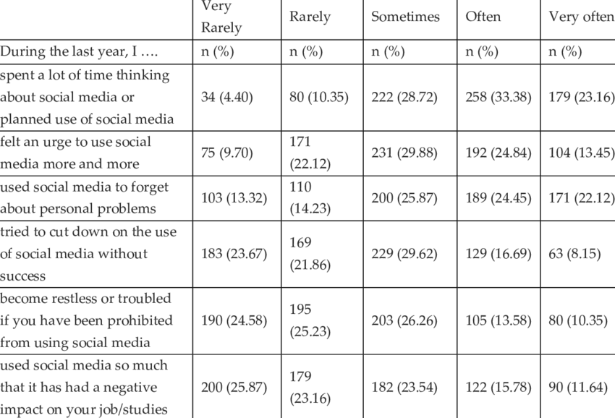
Items

Slide 27
Fear Of Missing Out (FoMO)
The Fear of Missing out Scale (FoMOS), developed Przybylski and colleagues in 2013 and is a 10-item unidimensional scale set on 5-point Likert type responses.

Slide 28
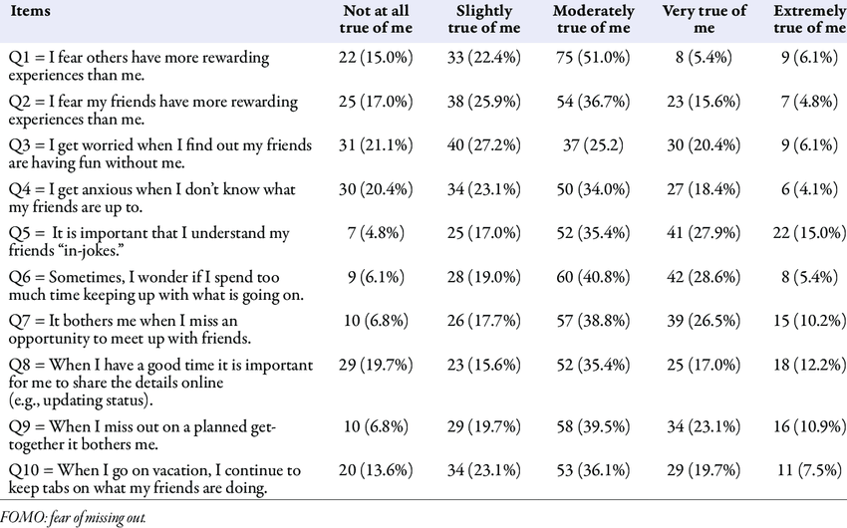
Items

Slide 29
Self Esteem
The Rosenburg Self Esteem scale, developed by Morris Rosenberg(1965) is used to measure self-esteem. Originally the measure was designed to measure the self-esteem of high school students. However, since its development, the scale has been used with a variety of groups including adults.

Slide 30
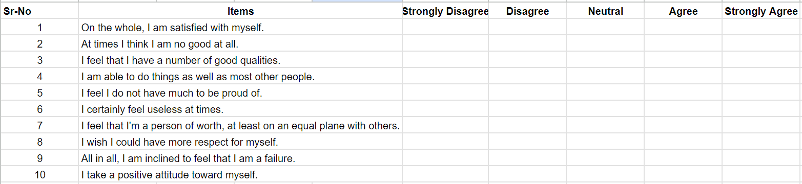
Items

Slide 31
Procedure
The Procedure for obtaining the result :
Data Collection
Sample Analysis
Measures

Slide 32
Data Collection
A google form was circulated. The data collection is completely
It contained 3 questionnaires for all the 3 variables.
10 questions about FOMO
10 questions about Self-Esteem
6 questions about Social Media Addiction
Responses from 220 people were recorded.
The results obtained were then analyzed and interpreted using statistics.

Slide 33
Sample
Total number of data points -> 221 participants.
Total number of valid data points -> 215 participants.
Gender – Male - 168 Students Female - 46 Students Others - 1 Student
Mean Age - 18.96
Median Age - 19

Slide 34
Measures
This Study comprises of 3 Measures:-
Bergen Social Media Addiction Scale
Fear of Missing Out Scale
Rosenberg Self-Esteem Scale

Slide 35
Data Analysis
We have used the SPSS software to do the following :
Reliability (Chronbach’s alpha)
Descriptive Analysis
Correlation

Slide 36
Variables | Reliability
Social Media Addiction | 0.6
FOMO | 0.79
Self-Esteem | 0.76
Reliability (Chronbach’s alpha)

Slide 37
Parameter | Mean | Median | Standard Deviation
Age | 18.95 years | 19 | 1.39
Year | 1.6 year | 1 | 0.87
Descriptive Analysis

Slide 38
Variables | Correlation Values
FOMO and Self-Esteem | -0.225
Social Media Addiction and Self-Esteem | -0.268
Social Media Addiction and FOMO | 0.342
Correlation

Slide 39
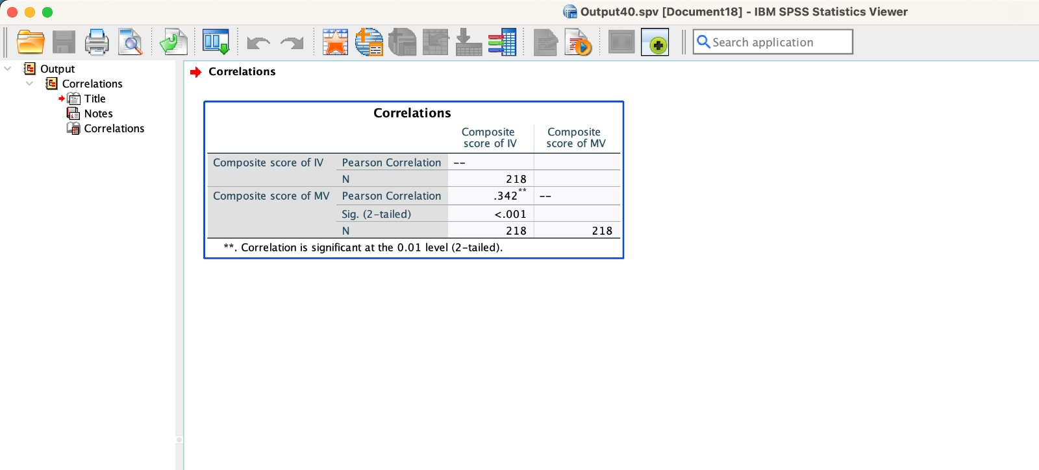
Results & Discussion
H1 : Social Media addiction will influence FOMO.

Slide 40
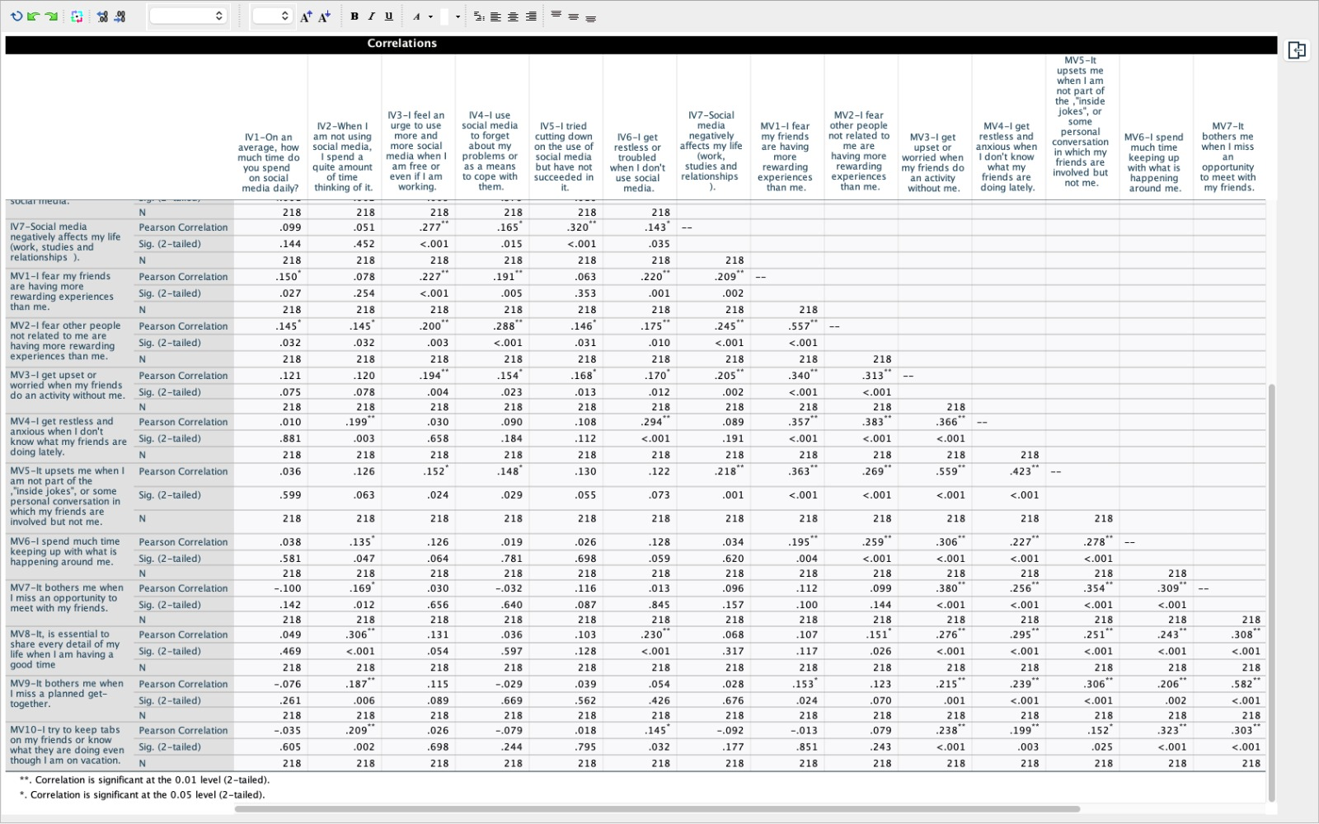
Social Media Addiction is positively Correlated with FOMO.
Social media creates more awareness of what goes around in one others’ lives. This creates more curiosity about these events and posts which increases the fear of being excluded.

Slide 41
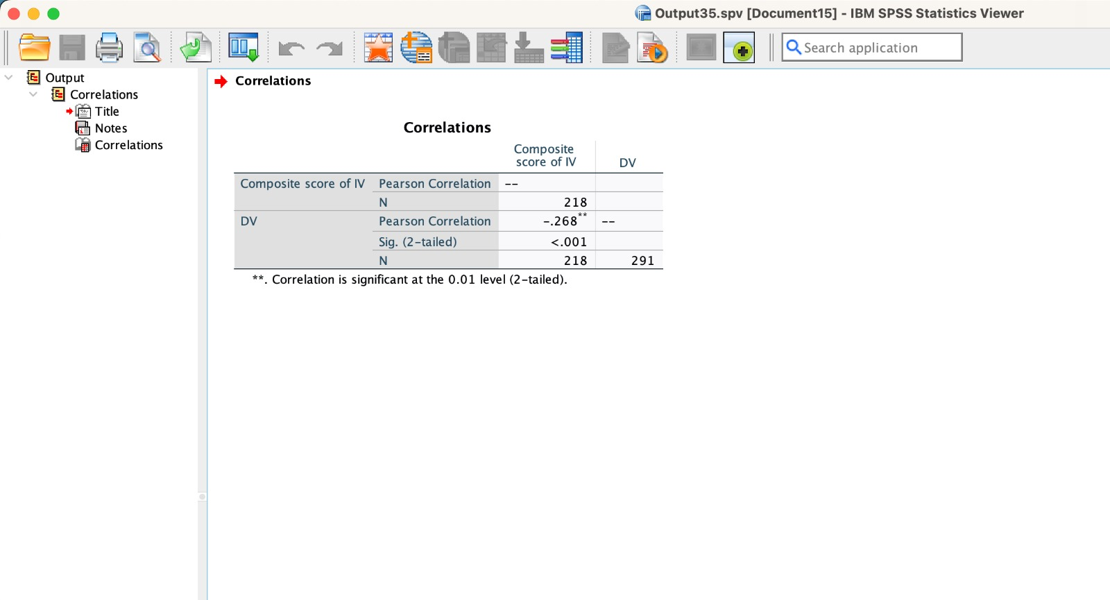
H2 : Social Media addiction will influence Self-Esteem.

Slide 42
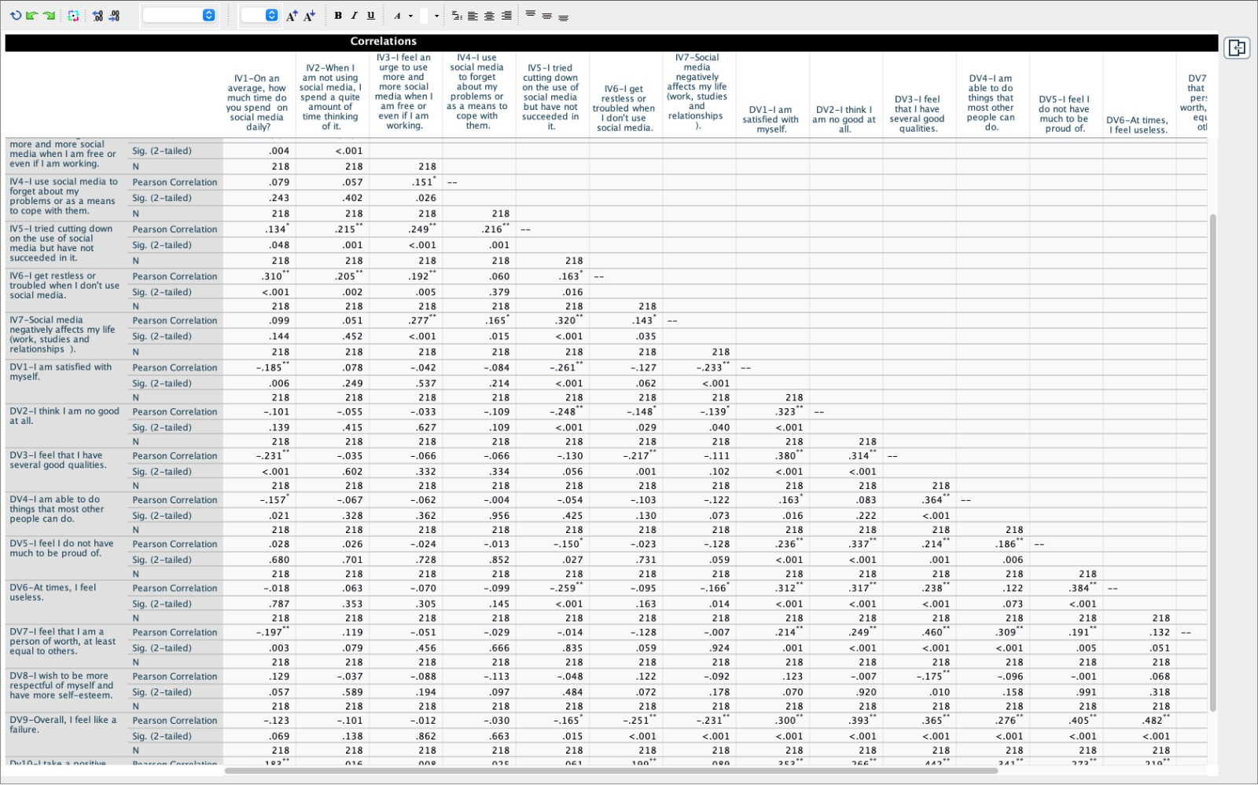
Social Media Addiction is negatively Correlated with FOMO.
Social media addiction leads to more comparison of the self with others having rewarding experiences. It also brings forth negative body image which decreases self-esteem.

Slide 43
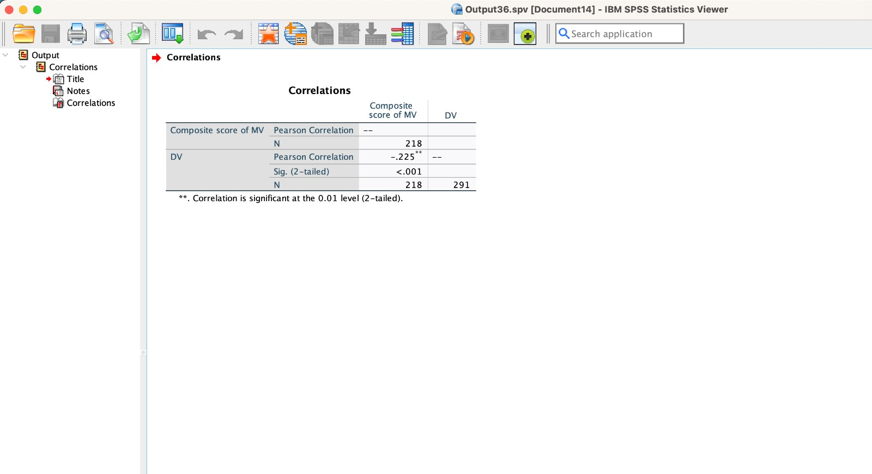
H3 : FoMO will influence Self-Esteem.

Slide 44
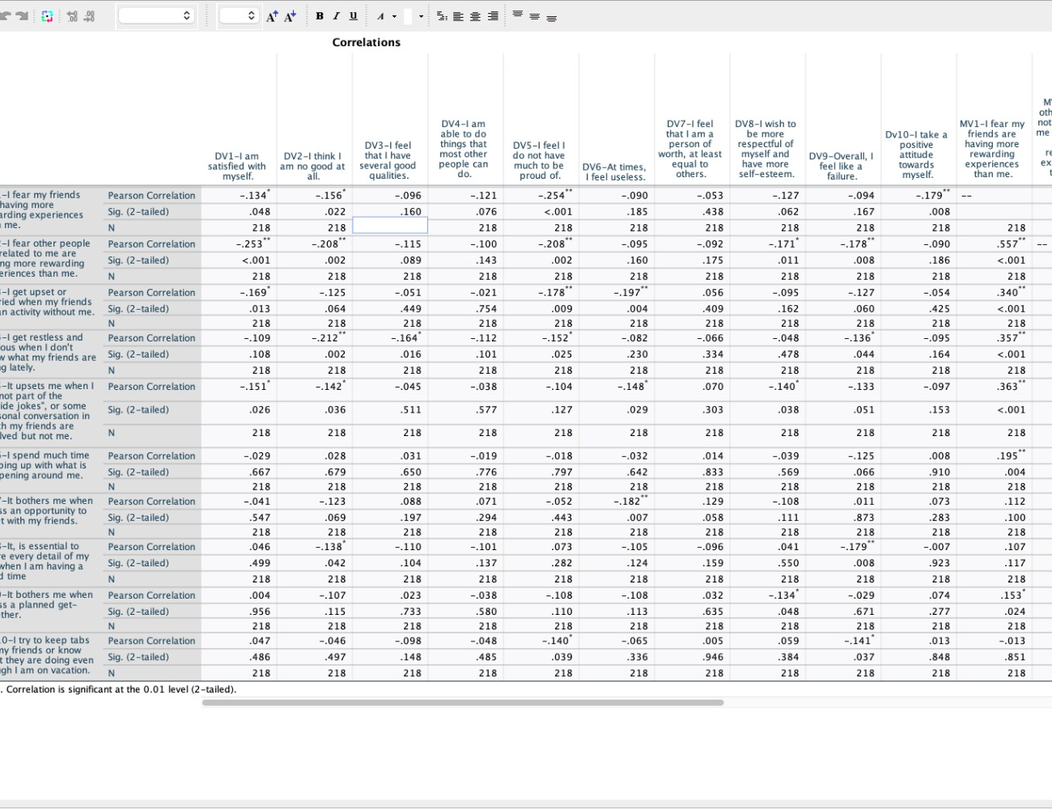
FOMO is positively correlated with Self-Esteem .
Spending excessive time in the virtual world can lead to feelings of isolation from real-life relationships. This lack of human interaction can negatively impact self-esteem, as individuals may begin to compare themselves to the virtual self.

Slide 45
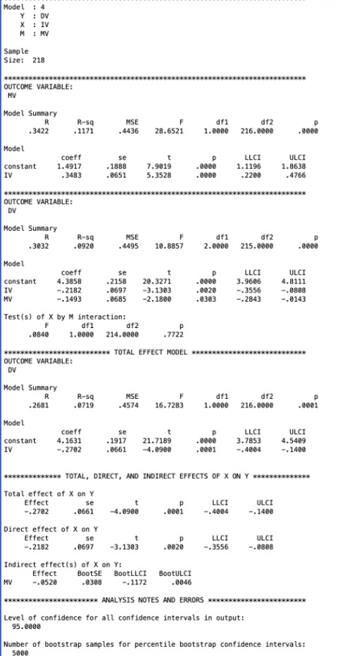
H4 : Social Media addiction will influence FOMO which in turn will affect Self-Esteem.

Slide 46
There is no mediation in the hypothesis . It is insignificant.
There is no effect of social media addiction on self esteem through the fear of missing out.

Slide 47
Implications
The obtained results can be used for counselling students.
It can be used as a basis for developing the theoretical understanding of the model for a mental tracker examining FOMO and Self-Esteem.
This study can be helpful in practicing mindful social media use and how to develop various coping mechanisms to help fight FOMO and social-comparison.
We can employ our study with C-Cell’s counselling programme and create a space to for encouraging more real-time relationships and connections.

Slide 48
Limitations
Smaller sample size.
Only one source of data.
Personal approach while collecting data.

Slide 49
References
Uram, P., & Skalski, S. (2022). Still Logged in? The Link Between Facebook Addiction, FoMO, Self-Esteem, Life Satisfaction and Loneliness in Social Media Users. Psychological Reports, 125(1), 218-231. https://doi.org/10.1177/0033294120980970
Przybylski A.K., Murayama K., DeHaan C.R., Gladwell V. Motivational, emotional, and behavioral correlates of fear of missing out. Comput. Hum. Behav. 2013;29:1841–1848. doi: 10.1016/j.chb.2013.02.014. [CrossRef] [Google Scholar]
Griffiths, M. (1996), "Behavioural addiction: an issue for everybody?", Employee Counselling Today, Vol. 8 No. 3, pp. 19-25. https://doi.org/10.1108/13665629610116872
Morris Rosenberg, Carmi Schooler, Carrie Schoenbach, Florence Rosenberg American Sociological Review, Vol. 60, No. 1 (Feb., 1995), pp. 141-156 (16 pages)
https://doi.org/10.2307/2096350
Who felt blue when Facebook went down? - The role of self-esteem and FoMO in explaining people's mood in reaction to social media outage Katarzyna Sekścińska, Diana Jaworska

